Slide 1
AI-Powered Real-Time Object Detection Dashboard
Zhang Dinggen 2024.12.20
Advisor: Hamza Djigal
Notes:
Our project is different from the previous one, we are an application-oriented project, so there won't be much algorithmic principles

Slide 2
contents
01
02
03
04
Introduction
Project Architecture Overview
Technical highlights in detail
Summary and outlook

Slide 3
Introduction
01.

Slide 4
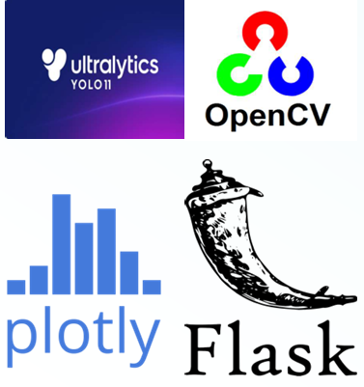
Introduction
In today's data-driven world, AI is transforming how we perceive and process information. This project uses AI models to analyze live video streams, detect objects, and help users better understand the visual data by showcasing key insights such as object count, detection frequency, and movement patterns.

Slide 5
Project Architecture Overview
02.

Slide 6
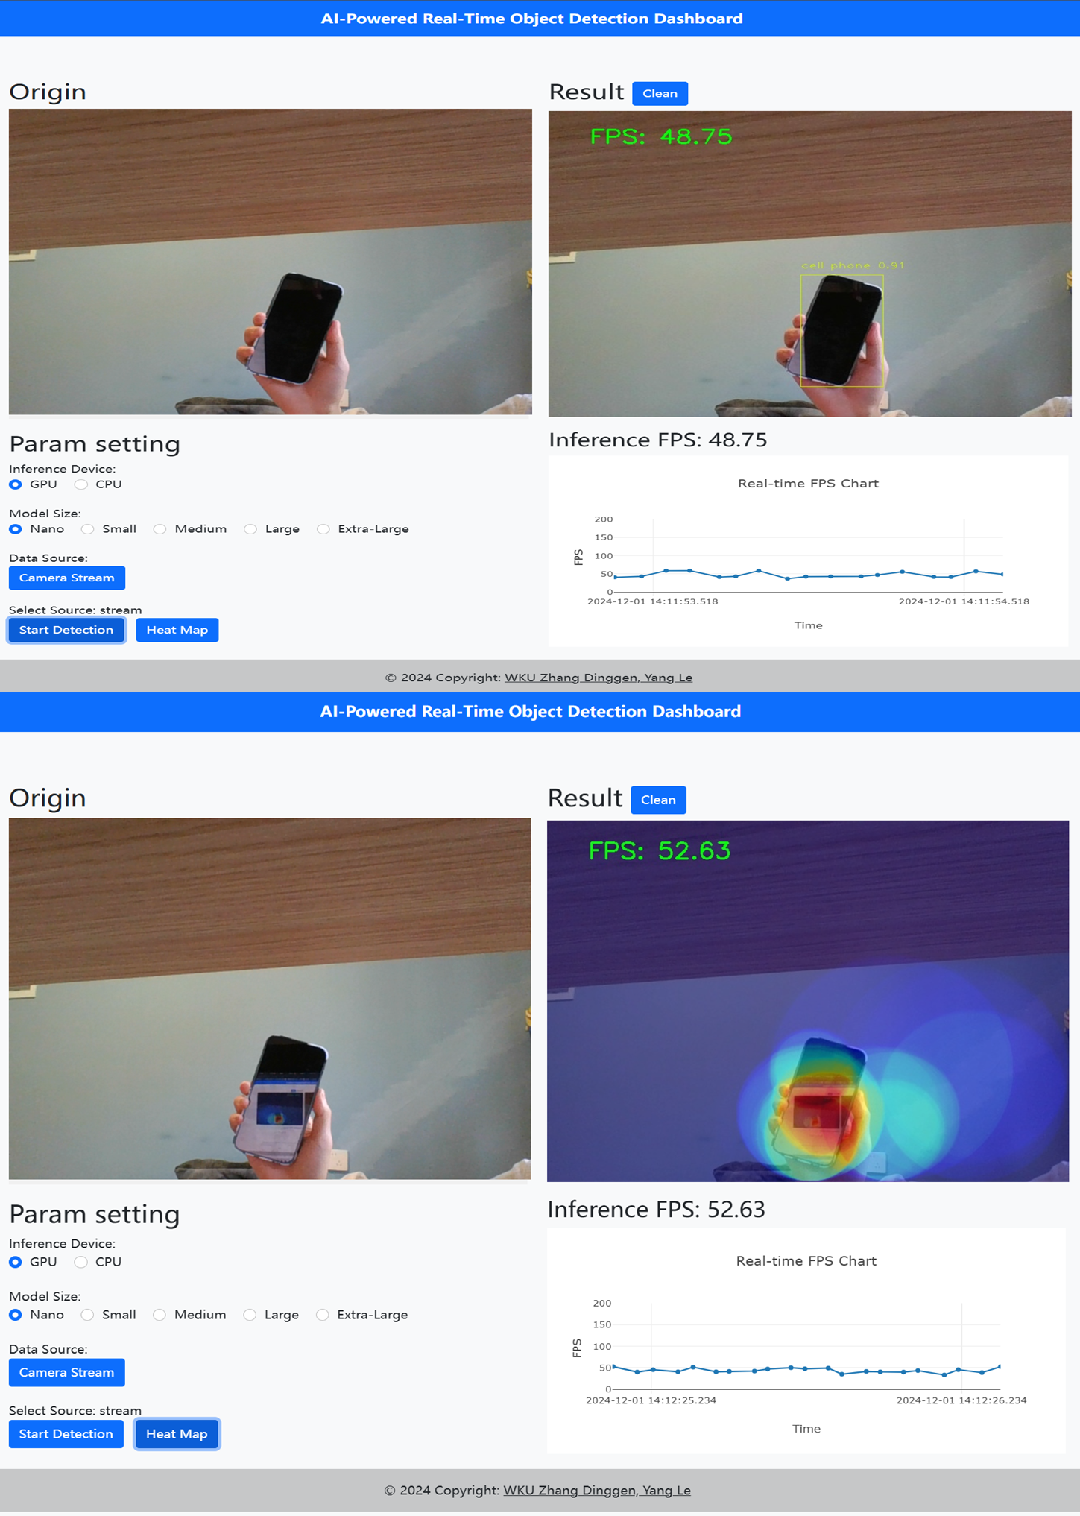
Frontend
Framework
What JavaScript does
The front-end of this project was built with HTML, CSS and JavaScript, using the Bootstrap framework to ensure a responsive layout and modern user interface.
JavaScript scripts handle user interactions, including video stream capture, parameter setting, and WebSocket communication with the backend.
Layout
FPS Chart
The front-end is divided into two main parts: the raw video/image display and the results presentation.Users can set up parameters and start the inspection through intuitive buttons and form controls.
The front-end integrates the Plotly.js library for real-time plotting of FPS frames to help users understand system performance in real time.

Slide 7
Backend
Framework
Real time communication
The backend is built using the Flask framework and is responsible for handling HTTP requests and WebSocket communication.
With Flask-SocketIO, real-time communication between server and client is realized, which is crucial for real-time processing of video streams.
Logic
The back-end files define the main logic of the application, including routing processing, parameter setting and video stream processing.
Model Loading
The backend is responsible for loading the YOLOv11 model and performing target detection or heatmap generation tasks based on requests from the frontend.

Slide 8
Model
Model
01
For model selection, we use the yolo v11 model.The model was released in September 2024 and is SOTA in all aspects of object detection
Detection
03
Analyze each frame of the image and draw bounding boxes around the detected targets while displaying the target category and confidence level .
Weight
02
For the model Weight, we did not use new data for training and used the officially provided pre-training weights.If recognition of new objects is required, the model can be Fine-Tune
HeatMap
04
A heat map of the target detection is generated to help the user understand the dense areas of the detection, the red areas are of highest concern for the model.

Slide 9
Technical highlights in detail
03.

Slide 10
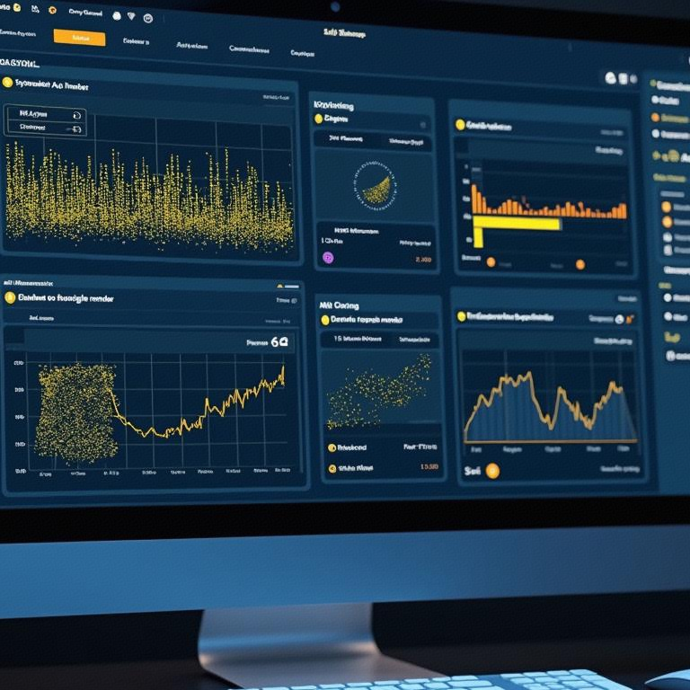
Real-time object detection
Real-time video analytics
The system is capable of detecting targets in the video stream in real time by analyzing each frame and drawing rectangular boxes around the detected targets while displaying the target category and confidence level.
User Interaction Experience
Performance Evaluation
Users can set parameters, upload files, and initiate testing through intuitive button and form controls, and the system provides the ability to set and adjust testing parameters.
The system calculates and displays frames per second (FPS) to evaluate model performance, using image processing libraries and the YOLOv11 model inference library, which provides powerful image processing and model inference capabilities.

Slide 11
Heat Map
Role
The heat map indicates the distribution of detected targets in the image through color changes, helping the user to understand the hot and cold spots in the detected area.
Data visualization tools
Heat maps are used as an intuitive data visualization tool to quickly identify high-risk or crowded areas within a surveillance area.
Dynamic update
The heat map can be dynamically updated based on real-time video streaming to ensure users get the latest detection results and help them make timely decisions.

Slide 12
FPS Chart
Dynamically updated FPS
The FPS frame rate graph is dynamically updated to show the real-time frame rate of the video stream processing, helping users to evaluate and optimize detection settings.
02
User feedback
03
Real-time data visualization provides users with valuable feedback to help them understand the real-time responsiveness and performance status of the system.
Real-time performance monitoring
Use the Plotly.js library to draw real-time FPS frame rate graphs on the front-end to help users visualize system performance.
01

Slide 13
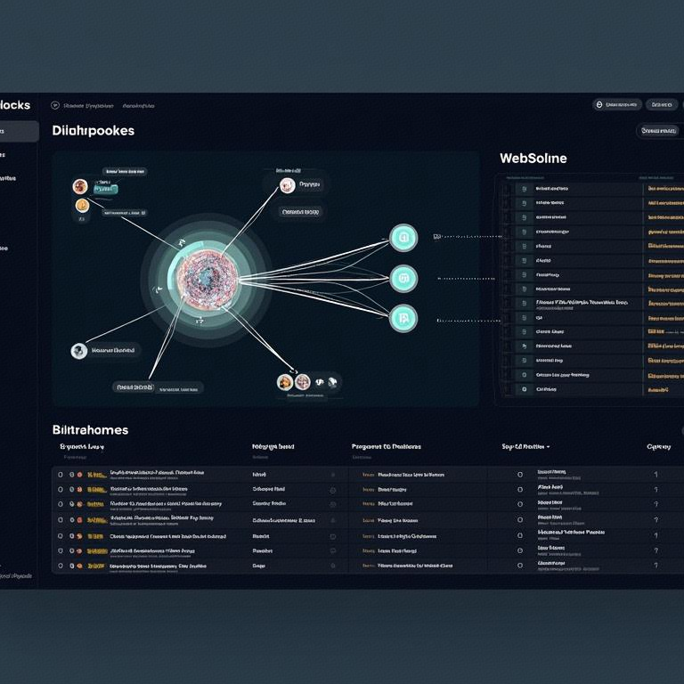
WebSocket
It is a data transfer protocol
Efficient data exchange
WebSocket communication is handled using the flask_socketio library to ensure efficient data exchange between the server and the client, which is critical for maintaining continuity and real-time video streaming.
Video streaming
As we all know, the capacity of video streaming is very large, and real-time transmission between front and back end is a challenge. With WebSocket, the processed video frames can be sent to the client in real time to ensure the real-time and continuity of video streaming transmission.

Slide 14
Summary and outlook
04.

Slide 15
Project Summary and Application Prospects
Project Summary
Technological convergence
Wide range of applications
Real time performance
This project's "AI-Powered Real-Time Object Detection Dashboard" combines deep learning models with web technologies to create a real-time object detection and analysis tool.
The project utilizes front-end frameworks (HTML/CSS/JavaScript and Bootstrap) as well as a back-end framework (Flask) to build the user interface and process the video stream.
The project has prospects for a wide range of applications in areas such as surveillance, transportation and retail.The real-time target detection and heat map generation features improve efficiency and safety in these areas.
By integrating the Plotly.js library, real-time FPS frame rate plotting is achieved, allowing users to visualize system performance and optimize detection settings.
https://github.com/Chaos0818/AI-Powered-Real-Time-Object-Detection-Dashboard

Slide 16
Thank You

